Slide 1
Classification of Moscow Metro stations using Foursquare data
Capstone Project - The Battle of Neighborhoods

Slide 2
introduction
For this project, we want to look at the neighborhoods surrounding metro stations and classify them.
Some neighborhoods are mostly residential, others have more business or commercial spaces surrounding them.
The venues closest to a station determine why and how people use it.
By analyzing this data we can classify stations by their primary usage.

Slide 3
dATA
We’ll need data on the location of stations and on the venues closest to them.
1. List of stations and their geographical coordinates — scraped from this Wikipedia page.
2. Foursquare API to explore venue types surrounding each station. Foursquare outlines these high-level venue categories with more sub-categories.
• Arts & Entertainment (4d4b7104d754a06370d81259)
• College & University (4d4b7105d754a06372d81259)
• Event (4d4b7105d754a06373d81259)
• Food (4d4b7105d754a06374d81259)
• Nightlife Spot (4d4b7105d754a06376d81259)
• Outdoors & Recreation (4d4b7105d754a06377d81259)
• Professional & Other Places (4d4b7105d754a06375d81259)
• Residence (4e67e38e036454776db1fb3a)
• Shop & Service (4d4b7105d754a06378d81259)
• Travel & Transport (4d4b7105d754a06379d81259)

Slide 4
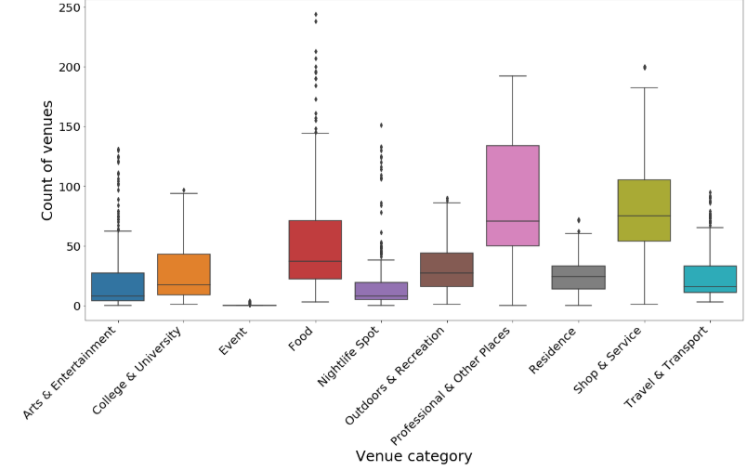
mETHODOLOGY
We can use the Foursquare explore API with category ID to query the number of venues of each category in a specific radius. The response contains a totalResults value for the specified coordinates, radius and category.
Exploratory analysis & basic cleanup Let’s look at the data. We can see for example that Turgenevskaya station has the highest number of Professional & Other Places (192) while Belokamennaya station has 0.
Let’s display the number of venues as boxplots (showing the average count, spread and outliers).

Slide 5
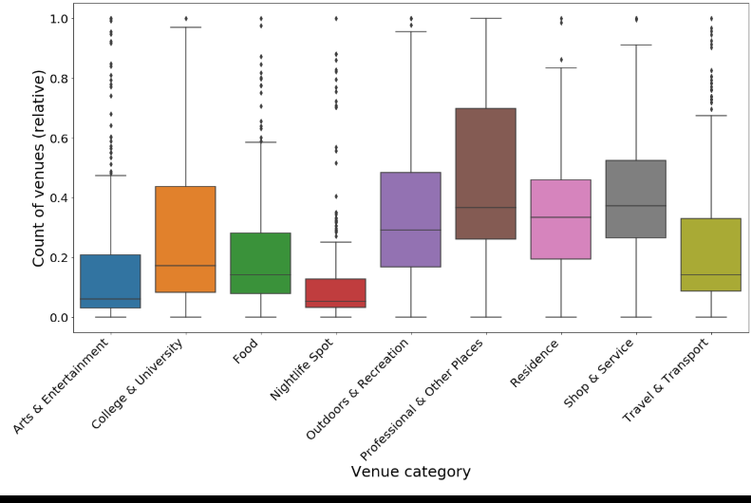
Data Preparation
Let’s normalize the data using min-max scaling (scale count of venues from 0 to 1 where 0 is the lowest value in a set and 1 is highest). This both normalizes the data and provides an easy to interpret score at the same time. The scaled diagram looks like this:

Slide 6
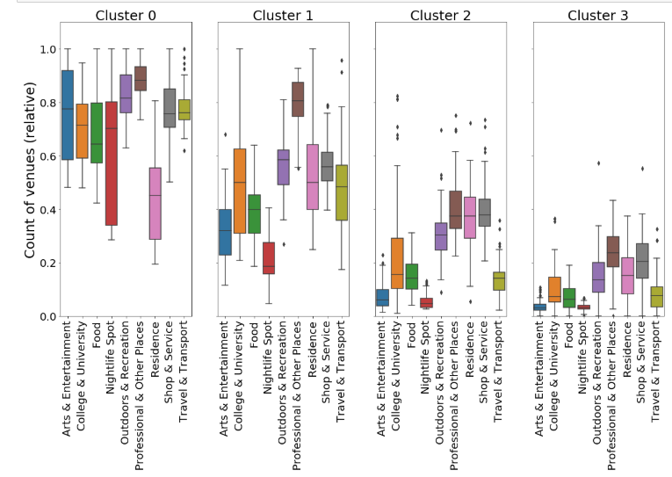
Clustering
We’ll be using k-means clustering. These were the preliminary results with different number of clusters:
• 2 clusters show the uptown/downtown divide
• 3 clusters add clustering within the downtown
• 4 clusters also identify neighborhoods with very low number of venues
• 5 and more clusters are difficult to interpret
For the final analysis let’s settle on 4 clusters (0 to 3). Let’s visualize the clusters profiles using boxplots.

Slide 7
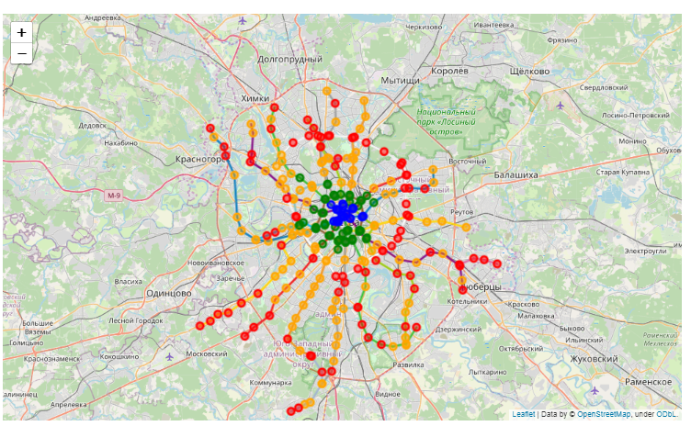
Plot

Slide 8
Result
Cluster 0 (Blue) has consistently high scores for all venue categories. This is the most diversely developed part of the city
Cluster 1 (Green) has highest marks for Professional & Other Places. This is the business part of the city.
Cluster 2 (Orange) has lower marks with best scores in Professional, Residence and Shop & Service.
Cluster 3 (Red) has low marks across the board. These appear to be underdeveloped areas.

Slide 9
Conslusion
Foursquare data is limited but can provide insights into a city’s development. This data could be combined with other sources (e.g. city data on number of residents) to provide more accurate results.

